Slide 1
IDENTIFYING
CODE SWITCHING IN TWEETS

Slide 2
GROUP NO. 8
Submitted By:
Himanshu Verma Nitesh Sekhar
Kalyan Kumar Riya Bubna
Sandeep Pan Shrey Garg Shubham Jain
Mentored By :
Dr. Monojit Choudhury
Pawan Goyal Koustav Rudra

Slide 3
Objective
Given tweets written in a mixture of English and Hindi, identifying the points where there is a change in language. If a language change is found, then identifying whether it is a code-switched point or not.

Slide 4
Clean Data
CRF
Re-Formatting the Data
Max-Ent
Format Data
(For Max-ENT)
Tag Classifier
(Using Manual Feature)
Decision Tree
Format Data
(For Decision Tree)
Tag Classifier
(Using Backoff)

Slide 5
Cleaning the original Tweets
We cleaned the whole data in 8 steps :
1. Remove all the tweet id’s
Regular Expression : \d{5,}
2. Remove all the usernames
Regular Expression : (\@(\w|\_)+(\:|))
3. Remove all the hashtags
Regular Expression : \#(\w|\_)+
4. Remove all the urls
Regular Expression : (http|https|ftp|mailto|tel):\S+[/a-zA-Z0-9]

Slide 6
Contd...
5. Replacing multiple occurrences of character or punctuation in word by twice the same character or punctuation
Regular Expression : (.)\1+ ---> \1\1
6. Remove digits as we don't need them
Regular Expression : \d+[^\s]*
7. Remove all these unnecessary punctuations
Regular Expression : \~|\@|\#|\$|\%|\^|\&|\*|\[|\]|\{|\}|\\|\/|\;|\:|\>|\<|\-|\_|\=|\+|\-|\*|\'|\"|\|
8. Convert these punctuation in dots
Regular Expression : \!|\(|\)|\.|\,|\? ---> \.

Slide 7
CONDITIONAL RANDOM FIELD (CRF)
CRF was used to make a language model for checking that the word is English or Hindi .The template file was made which had different features which related the current word with the tag of the previous two words and the next two words to mark the tag of the current word. CRF model was created by using that template file and train file which contained around 24000 tweets with around 5 lakh words.

Slide 8
Features
To train the data, we needed some features to identify when there is a case of code switching. These features include:
A binary value to denote the existence of trigrams, bigrams and unigrams before and after any point of language change.
The presence of punctuation after any word.
Any word has language english or hindi.
If language change is encountered after any word.
If a language change is encountered at position ‘i’, then the present word is present at a position at least ‘i+3’

Slide 9
We used a test-file which contained code switched Data to test our features.
The accuracy came out to be around 30.7 %
However, we realized that there were a lot of sentences in the file which were neither code-switching or mixing :
eg : mein school jaa rha hun .
Here, we obtained change tags after mein and school . However such points can’t be classified as language-change points .
Hence after removing these points, out accuracy came to be about 70.82% (even 83% in one test file)
RESULT OF DETERMINISTIC MODEL

Slide 10
Max Ent Model
Features :
For each tag, distance from the previous and the next tag .
Sliding window centered around the current word and encoding this information in the form of an integer.
Result :
If we consider the entire file as code switching,accuracy is around 51%.
However considering code-mixing in the data, accuracy comes to around 80% .

Slide 11
Decision Tree
A decision tree is a graph that uses a branching method to illustrate every possible outcome of a decision. Decision Trees are excellent tools for helping you to choose between several courses of action. They provide a highly effective structure within which you can lay out options and investigate the possible outcomes of choosing those options .
In our project, we used a python implementation of a decision tree model to determine whether or not a word is a code switching point or not. We used the following attributes while training the decision tree and for testing the output.

Slide 12
Decision Tree Results
Attributes for Decision Tree :
Initial_trigram? , Initial_bigram? , Initial_unigram? , End_trigram? , End_bigram? , End_unigram? , LanguageEng? , distance_from_prev_change , Punctuation?
Result
Considering all the language change points as code switch, the accuracy had come to around 24% . But as we had seen earlier , removing change points with only two words between them is sure to increase the accuracy by at least 20% more.

Slide 13
Input
Indian batsman itna slow khel rahe he ki lagta he is se fast to out of form sehwag and sachin khel lete... #IndvsSA
@NitishKumar Sir Aaj aap jit kaye aur hum bihari har gaye, was just reading comment from people who are not bihari and got d same feeling of 90s
Output for Deterministic Model
indian <xx> batsman <xx> itna <xx> slow <cs> khel rahe <xx> he <xx> ki lagta <cs> he is <cs> se <xx> fast to out of form <cs> sehwag <xx> and <xx> sachin khel lete
sir <xx> aaj aap jit kaye aur <xx> hum <xx> bihari har gaye <cs> was just reading comment from people who are not <cs> bihari <xx> and got d same feeling of
Output for Max-Ent Model
indian <Code-Mixed> batsman <Code-Mixed> itna <Code-Mixed> slow <Code-Mixed> khel rahe <Code-Mixed> he <Code-Mixed> ki lagta <Code-Mixed> he is <Code-Mixed> se <Code-Mixed> fast to out of form <Code-Mixed> sehwag <Code-Mixed> and <Code-Mixed> sachin khel lete .
sir <Code-Mixed> aaj aap jit kaye aur <Code-Mixed> hum <Code-Mixed> bihari har gaye . <Code-Switched> was just reading comment from people who are not <Code-Switched> bihari <Code-Switched> and got d same feeling of

Slide 14
sir = no aaj = no aap = no jit = no kaye = ? aur = no hum = ? bihari = no har = no gaye = yes was = no just = no reading = ? comment = no from = no people = no who = no are = no not = ? bihari = no and = no got = no d = no same = no feeling = no of = no
Output for Decision tree
word = no
indian = no
batsman = ?
itna = no
slow = ?
khel = no
rahe = no
he = no
ki = no
lagta = no
he = no
is = ?
se = no
fast = no
to = no
out = no
of = no
form = no
sehwag = no
and = no
sachin = no
khel = no
lete = ?

Slide 15
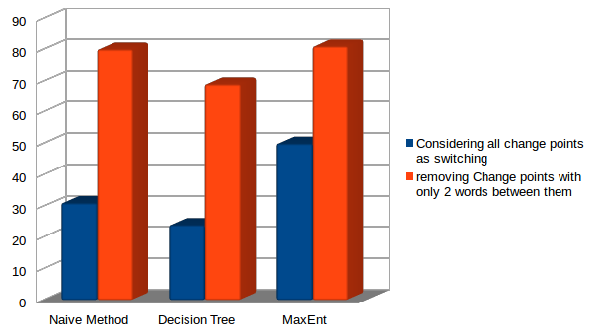
Conclusion

Slide 16
THANKS!

